Slide 1
Imputation of Variables in the State Inpatient Database (SID)
DATS 6202 - Machine Learning I
George Washington University
David Robison and Nathan Zencey
Notes:
Review that we used Naïve Bayes, Random Forest, and Gradient Boosted Trees

Slide 2
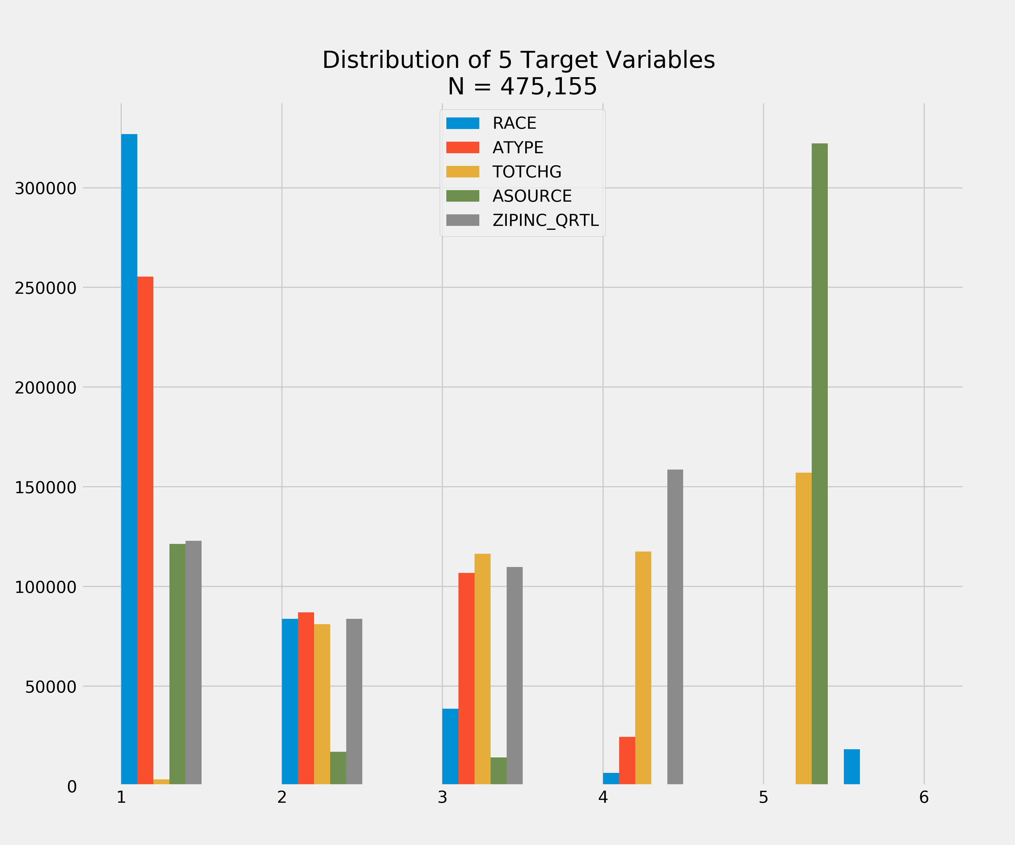
The Class Imbalance Problem for Classification Learning Algorithms
 | 1 | 2 | 3 | 4 | 5 | 6
RACE | 68.8% | 17.6% | 8.16% | 1.38% | 0.15% | 3.87%
ATYPE | 53.7% | 18.3% | 22.5% | 5.2% | 0.15% | 0.15%
TOTCHG | 0.67% | 17.1% | 24.5% | 24.7% | 33.1% | NA
ASOURCE | 25.5% | 3.6% | 3.0% | 0.02% | 67.8% | NA
ZIPINC | 25.9% | 17.6% | 23.1% | 33.4% | NA | NA
Note: ZIPINC was converted from a continuous variable to a binned ordinal variable with values: 1: 0 – 1,000; 2: 1,001 – 5,000; 3: 5,001 – 10,000; 4: 10,001 - 20,000; 5: 20,000– 1,500,000
Notes:
Class imbalance, >50% The literature consistently makes two recommendations for imbalanced data: cost sensitive learning, where a high cost is assigned to
misclassified minority classes, or resampling the data to down-sample the majority class, oversample the
minority class, or both7.

Slide 3
Cross Validated Comparison of Classification Performance
 | Model | Accuracy | Precision | Recall | Average f-1 Score
RACE: Null: 68.77% | Naive Bayes | 69.05% | 0.99 | 0.69 | 0.81
 | Random Forest | 72.83% | 0.74 | 0.73 | 0.73
 | Gradient Boost | 76.84% | 0.74 | 0.77 | 0.74
ZIPINC_QRTL Null: 33.33% | Naive Bayes | 35.22% | 0.65 | 0.35 | 0.45
 | Random Forest | 62.30% | 0.61 | 0.62 | 0.61
 | Gradient Boost | 60.64% | 0.59 | 0.61 | 0.60
ASOURCE Null: 67.82% | Naive Bayes | 65.75% | 0.85 | 0.66 | 0.73
 | Random Forest | 94.00% | 0.94 | 0.94 | 0.94
 | Gradient Boost | 92.69% | 0.92 | 0.93 | 0.92
ATYPE Null: 53.74% | Naive Bayes | 60.84% | 0.67 | 0.61 | 0.63
 | Random Forest | 89.54% | 0.89 | 0.90 | 0.89
 | Gradient Boost | 87.12% | 0.87 | 0.87 | 0.87
TOTCHG Null: 33.10% | Naive Bayes | 41.58% | 0.48 | 0.42 | 0.44
 | Random Forest | 79.14% | 0.79 | 0.79 | 0.79
 | Gradient Boost | 72.58% | 0.73 | 0.73 | 0.72

Slide 4
Comparison of Random Forest Performance on Class Imbalanced and Resampled Data
Race | Class 1 | Class 2 | Class 3 | Class 4 | Class 5 | Class 6 | Accuracy
Imbalanced F1-Score (Sample Size) | 0.88 (218876) | 0.49 (56256) | 0.43 (25949) | 0.02 (4398) | 0.02 (491) | 0.36 (12383) | 76.50%
Majority Undersample: F1-Score (Sample Size) | 0.88 (50000) | 0.51 (20000) | 0.49 (15000) | 0.08 (4933) | 0.01 (550) | 0.38 (13824) | 75.90%
Majority Undersample: F1-Score (Sample Size) | 0.85 (10000) | 0.53 (6000) | 0.47 (3500) | 0.12 (2000) | 0.07 (550) | 0.38 (3000) | 72.83%
Minority Oversample: F1-Score (Sample Size) | 0.88 (34302) | 0.52 (34302) | 0.44 (34302) | 0.02 (34302) | 0.01 (34302) | 0.36 (34302) | 76.36%

Slide 5
Conclusions
Severe class imbalances present a challenge for classification models.
Strategies to handle class imbalance such as resampling (down sampling or oversampling) may improve performance (accuracy score/F1), however, experimentation is required to identify optimally resampled data.
A mix of ensemble classifiers and anomaly detection models may provide a better learning framework.

